Slide 1


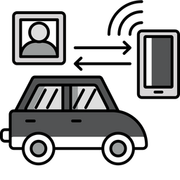
INTRODUCING
VOLT-AI
SMART ASSISTANT FOR YOUR VEHICLE
By - Team 4
Abhijith Raj Urs Ravishankar, Harshitha Bangalore Ramachandra, Sanjana Rao

Slide 2


CONTENTS
Problem Statement
Solution Overview
Flowchart and Architecture
LLMs, APIs and Libraries Used
Technical Implementations
UI/UX - Gradio and Loveable
Improvements and Future Scope
Thank you & Team Contributions

Slide 3


PROBLEM STATEMENT
Modern vehicles are equipped with a wide range of sensors and onboard diagnostics capable of generating vast amounts of performance and health data. However, this data often remains underutilized due to a lack of intelligent systems that can interpret it in real-time and present actionable insights to the driver. As a result, vehicle owners face challenges such as unexpected breakdowns, inefficient fuel usage, delayed maintenance, and difficulty understanding warning indicators, leading to higher costs, and stress.

Slide 4



SOLUTION OVERVIEW
VoltAI is an AI-powered smart assistant tailored for vehicles, offering real-time diagnostics, alert generation, efficiency suggestions, and predictive maintenance. By leveraging vehicle telemetry data and integrating large language models (LLMs), VoltAI translates raw data into actionable insights.
Vehicle Health Analyst
Alert Generator
Fuel Efficiency Advisor
Maintenance Predicator
Monitors engine, temperature, and system
Flags anomalies like low tire pressure or engine faults
Analyzes consumption trends to suggest improvements
Anticipates servicing needs before breakdowns occur.

Slide 5

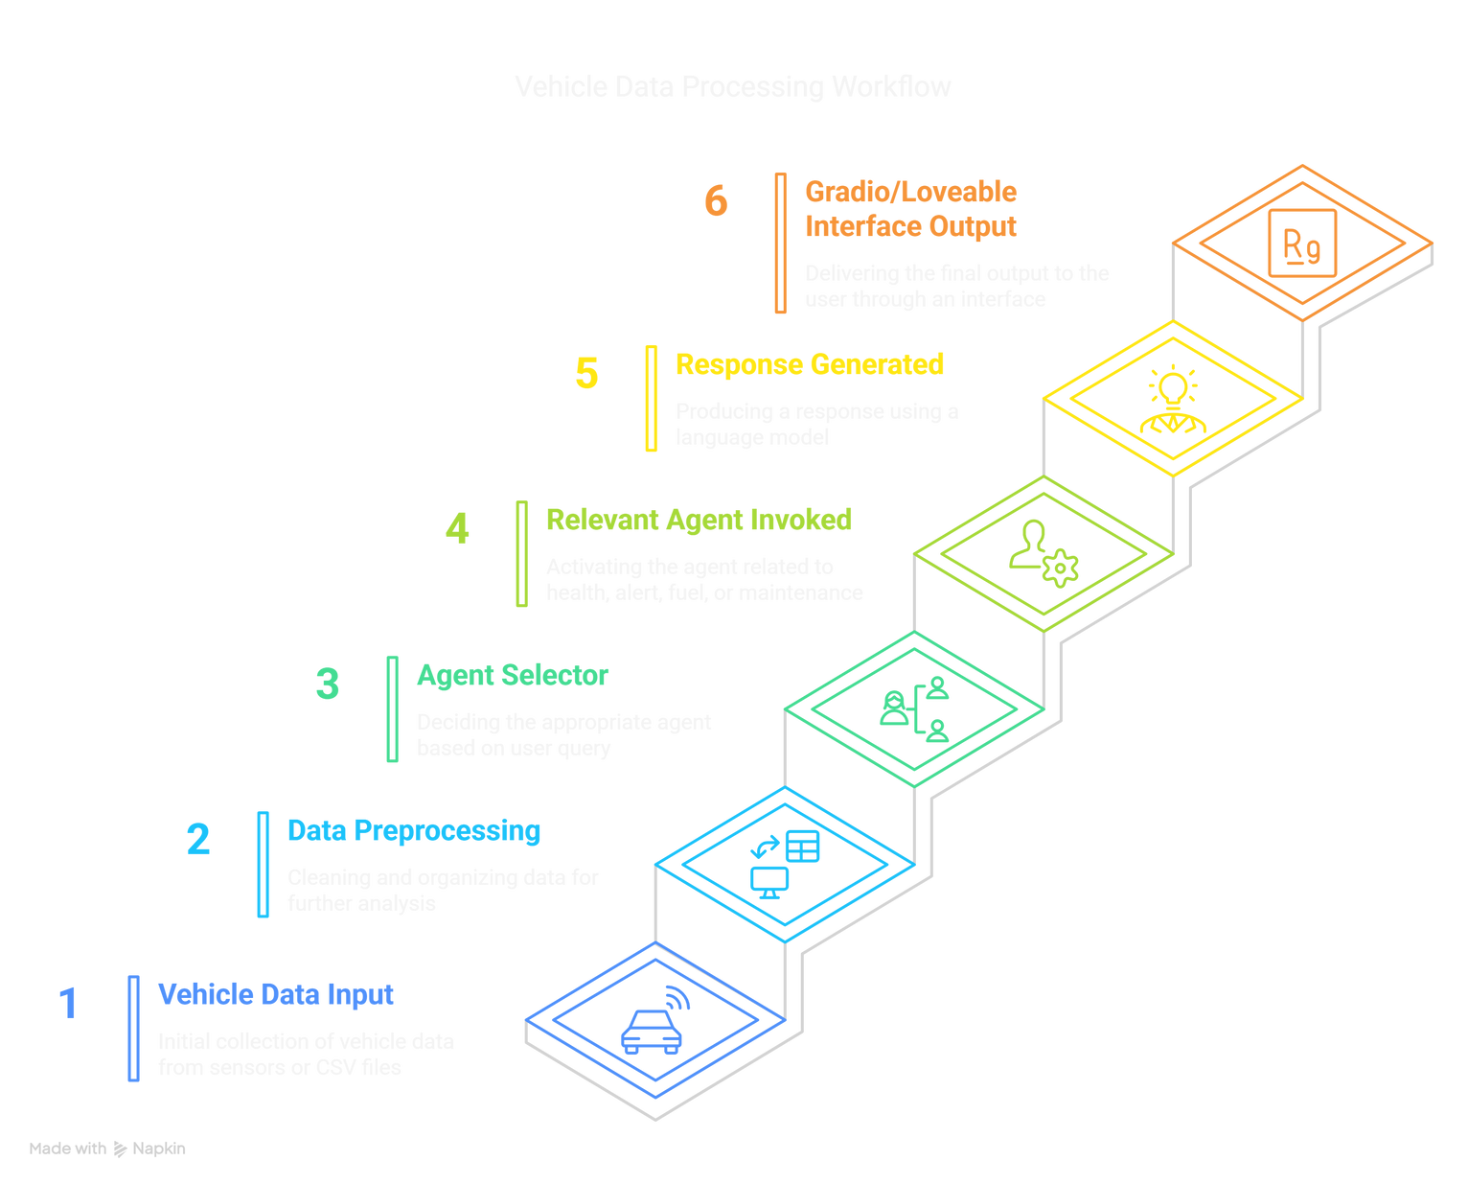
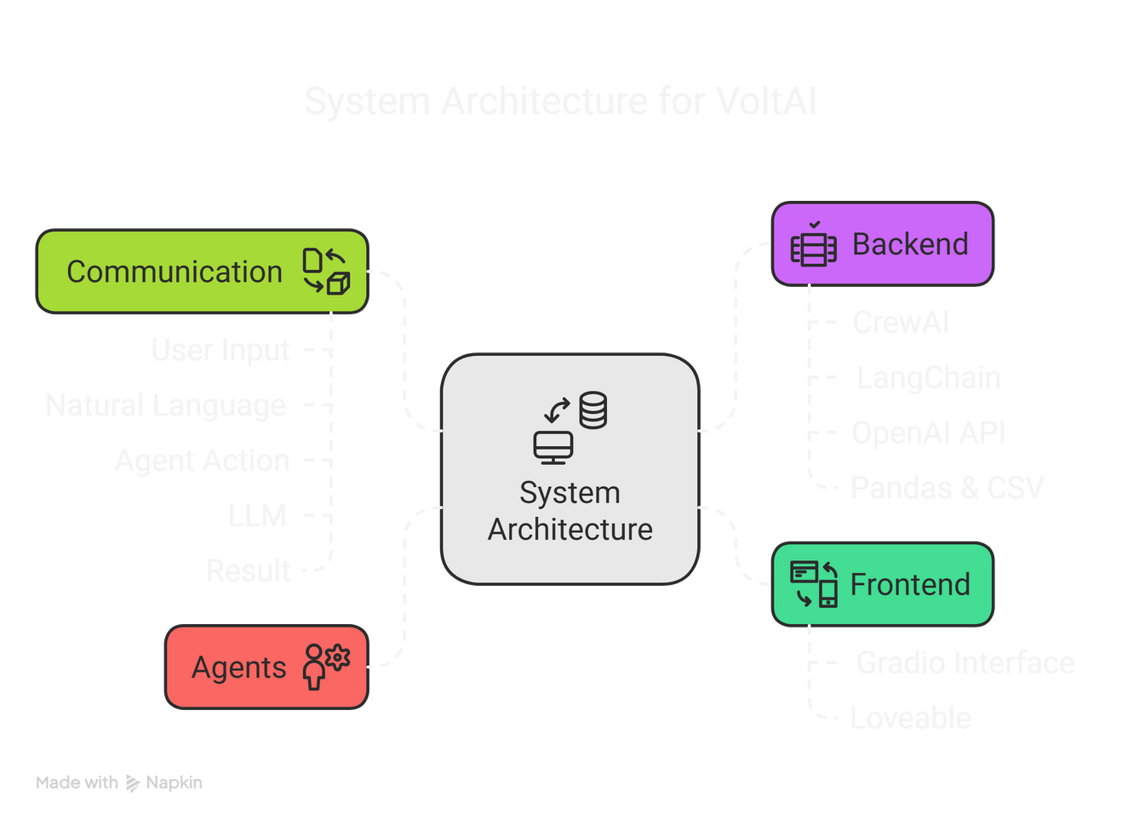
FLOWCHART AND ARCHITECTURE

Slide 6










LLMS, APIS AND LIBRARIES USED

Slide 7
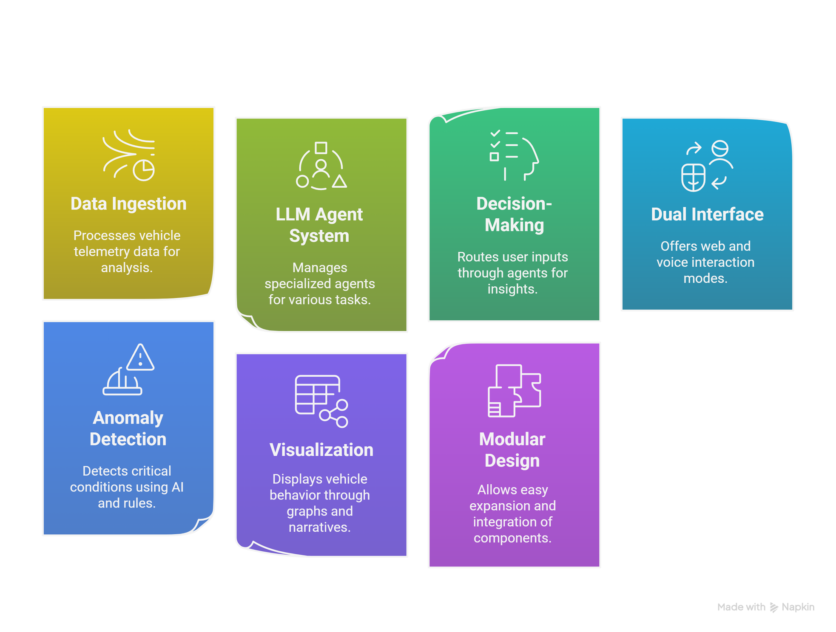

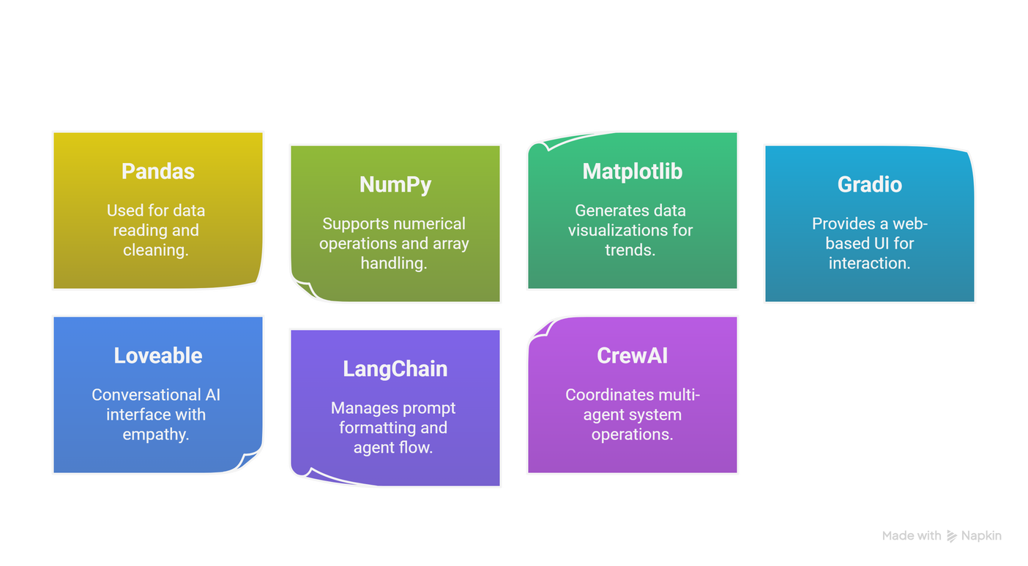
TECHNICAL IMPLEMENTATIONS

Slide 8
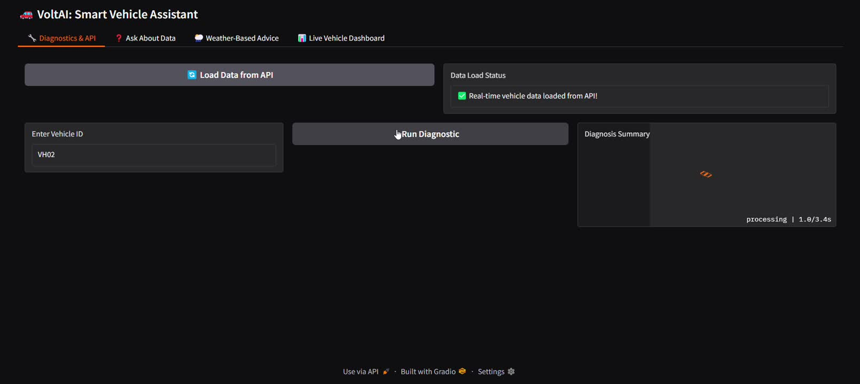
UI/UX - GRADIO

Slide 9
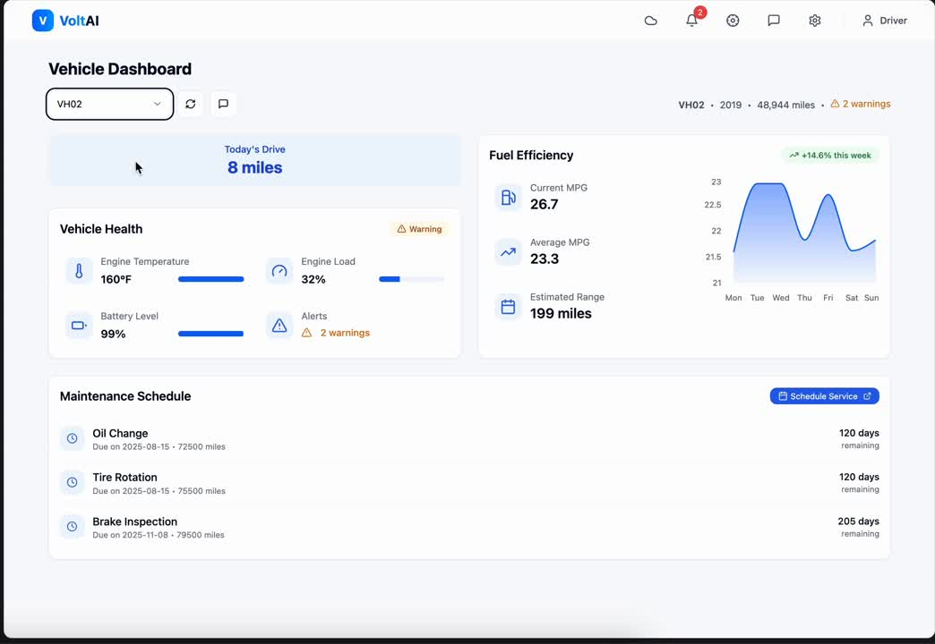
UI/UX - LOVEABLE

Slide 10





IMPROVEMENTS & FUTURE SCOPE
REAL-TIME DATA FEED
VOICE INTERFACE
CUSTOM AGENT TRAINING
SECURITY LAYER
Integrate OBD-II devices for live vehicle data.
Extend VoltAI to iOS/Android with push alerts
Incorporate speech recognition and TTS for hands-free use.
Custom behaviors per make/model.
Fine-tune LLMs with automotive-specific corpora.
Use AI to offer safer driving suggestions.
Add authentication and data privacy layers.
Context-aware suggestions (e.g., "Check tire pressure before long trip")

Slide 11
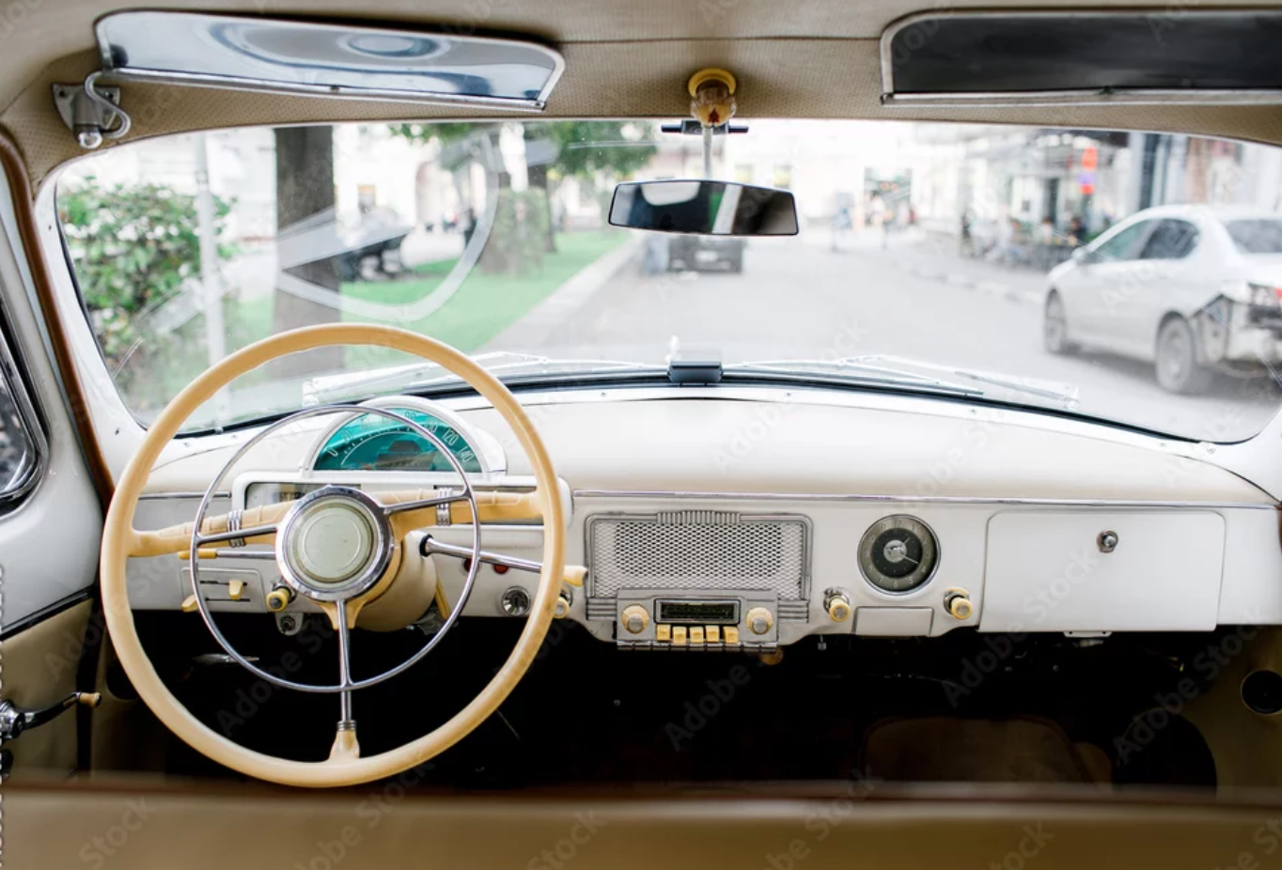
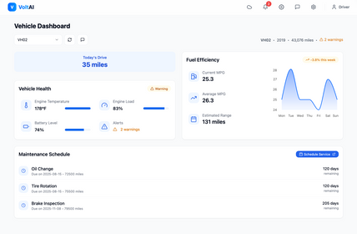
THANK YOU
We are open to any questions or comments
Team 4
*T&C Apply

Slide 12

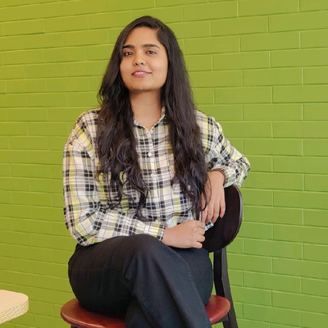

TEAM 4 - CONTRIBUTIONS
Abhijith Raj Urs (002473146)
Harshitha (002485894)
Sanjana (002473503)
Set up the Gradio interface, integrated the Loveable voice assistant, and initialized the datasets and API scaffolding.
Implemented some of the core vehicle functionalities, including alert generation and diagnostics.
Developed the Gemini-based insights and implemented the data visualizations and charts.
Designed and compiled the final project presentation (PPT).
Integrated the Open-Meteo Weather API and developed the CrewAI multi-agent system.
Implemented the core vehicle functionalities, including predictive maintenance and health analyst

